Slide 1

FACE DETECTION USING PCA
(EIGENFACES)
Your Name | Course/Subject | Date

Slide 2
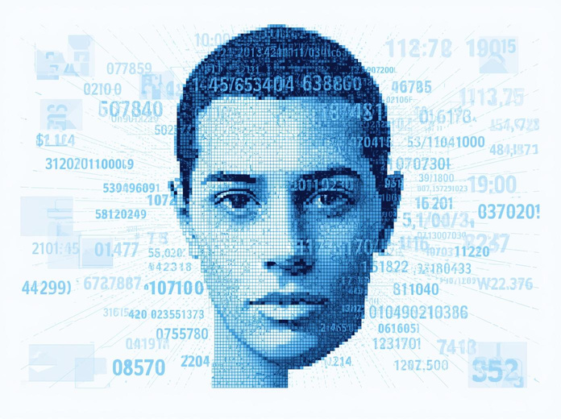
Problem Statement
Images are inherently high-dimensional data. A modest 100 × 100 pixel image contains 10,000 features. Processing such data is computationally slow and highly redundant. The challenge: reduce dimensionality while preserving the essential information needed for accurate face detection.

Slide 3
Image Representation
Each pixel in an image represents an intensity value (0-255 for grayscale). This numerical representation allows us to treat images as mathematical objects for computational processing.
Convert 2D image into 1D vector by flattening rows. A 100×100 image becomes: x ∈ ℝ¹⁰⁰⁰⁰. This vectorization enables matrix operations essential for PCA analysis.

Slide 4
Dataset Matrix
Collect N training images and form the data matrix: X = [x₁ x₂ ... xₙ] where each column xᵢ represents a flattened face image vector.
Matrix dimensions: 10,000 × N (rows = pixels per image, columns = number of training samples). This matrix forms the foundation for PCA analysis.

Slide 5
Mean Face
Computing the Average
The mean face is computed by averaging all training images: μ = (1/N) Σ xᵢ, where N is the total number of face images and xᵢ represents each individual face vector.
Capturing Average Structure
The mean face captures the general facial pattern shared across all training samples. It represents the average pixel intensities and removes individual-specific features, serving as the baseline for measuring variations.

Slide 6
Data Centering
Normalize each image by subtracting the mean face:
φᵢ = xᵢ − μ
This centers the data around zero, ensuring PCA focuses on variations between faces rather than absolute pixel values.
1.
Form the centered data matrix from all normalized images:
A = [φ₁ φ₂ ... φₙ]
Each column represents a mean-centered face vector, ready for covariance analysis.
2.

Slide 7
Covariance Concept
Covariance Matrix Definition
The covariance matrix C = AAᵀ measures how pixel values vary together across all face images. High covariance between pixels indicates they change together, revealing structural patterns in facial data.
The Size Challenge
For 100×100 images, C has size 10,000 × 10,000 = 100 million elements. Computing and storing this matrix directly is computationally expensive and often impractical for real-world applications.

Slide 8
Dimensionality Trick
The Computational Challenge
Computing C = AAᵀ directly yields a 10,000 × 10,000 matrix, which is computationally expensive. Instead, we exploit a mathematical trick using the smaller matrix C' = AᵀA with size N × N, where N is the number of training images.
Eigenvalue Problem Solution
Solve the eigenvalue problem: C'v = λv for the smaller N × N matrix. The eigenvectors of the original covariance matrix can then be recovered by computing u = Av, making PCA tractable for high-dimensional face images.

Slide 9
Eigenfaces Computation
Convert eigenvectors: u = Av (where A is the centered data matrix and v are eigenvectors of AᵀA)
Normalize u to unit length to ensure consistent magnitude across all eigenfaces
Result: u = Eigenfaces — principal directions that capture maximum variance in face data

Slide 10
Interpretation of Eigenfaces
Patterns of Variation
Each eigenface represents a principal direction of variation in the face space. These are not actual faces, but abstract patterns that capture the most significant ways faces differ from the mean face.
What Eigenfaces Capture
Eigenfaces encode variations in lighting conditions, facial structure differences, and distinctive feature patterns. Higher-ranked eigenfaces capture global features while lower-ranked ones represent finer details.

Slide 11
Variance & Selection
Eigenvalues indicate importance: λ₁ ≥ λ₂ ≥ ... ≥ λₙ rank the significance of each eigenface in capturing facial variation.
Sort eigenfaces by eigenvalues: Arrange eigenfaces U = [u₁ u₂ ... uₙ] in descending order of their corresponding eigenvalues.
Keep top k eigenfaces where k ≪ 10,000: Select only the most significant components to achieve dimensionality reduction while preserving variance.

Slide 12
Projection
Feature Extraction Formula
Project any face image into the eigenface subspace using the transformation: w = Uᵀ(x − μ), where U contains the top k eigenfaces, x is the input face vector, and μ is the mean face.
Resulting Representation
The projection yields a k-dimensional weight vector w that compactly represents the original 10,000-dimensional face image. This compressed representation enables efficient storage and fast comparison for recognition tasks.

Slide 13
Recognition
Distance Metric
Compare projected face vector w with stored training vectors wᵢ. Calculate Euclidean distance: d = ‖w − wᵢ‖. The minimum distance indicates the closest match in the face database.
Classification Decision
If min(d) < threshold τ → Face recognized as identity i. If min(d) > threshold τ → Unknown face or rejection. Nearest neighbor classification provides simple yet effective matching for eigenface recognition.

Slide 14
Geometric Intuition
Faces lie in high-dimensional space where each pixel represents a dimension, creating a vast feature space that is computationally challenging to navigate directly.
PCA finds new axes called principal components by rotating the coordinate system to align with directions of maximum variance in the face data.
Data is projected onto a lower-dimensional subspace, preserving the most significant variations while dramatically reducing computational complexity.

Slide 15
Why PCA Works
Removes Redundancy: Correlated pixels are combined into fewer, independent components, eliminating repetitive information across the image.
Maximizes Variance: Principal components capture the directions of greatest variation, preserving the most discriminative facial features.
Filters Noise: By discarding components with low eigenvalues, PCA naturally suppresses noise and minor variations like lighting changes.

Slide 16
Conclusion
PCA effectively reduces dimensionality of face images from thousands of pixels to a compact feature vector, enabling efficient storage and processing.
Eigenfaces represent the principal components of face variations, capturing essential facial features while filtering out noise and redundancy.
The method enables efficient face recognition through simple distance-based matching in the reduced eigenface subspace.

Slide 17
Conclusion
PCA effectively reduces high-dimensional image data (10,000+ features) to a compact, manageable representation while preserving essential facial information.
Eigenfaces are the principal components of face images, capturing the most significant patterns of variation across the training dataset.
This approach enables efficient face recognition through simple distance-based matching in a low-dimensional subspace.

Slide 18
THANK YOU

